Slide 1


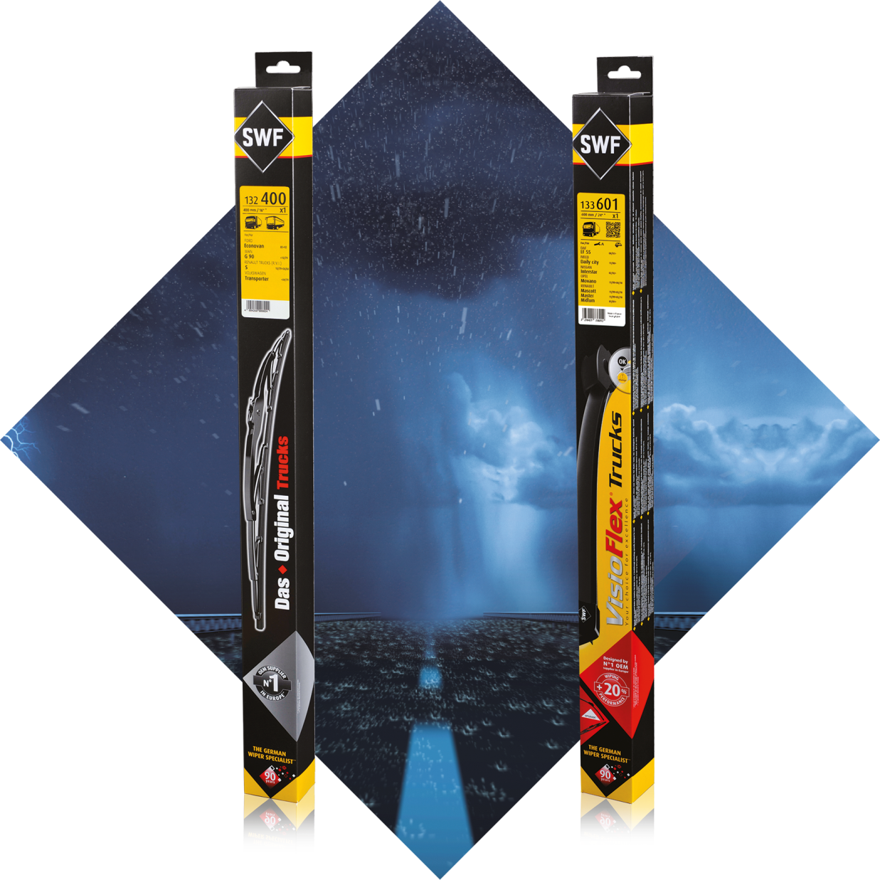

COMMERCIAL VEHICLES
WIPERS
Providing the cleanest windscreen with SWF wipers allows you to drive safer

Slide 2



The full wipers offer
From 400mm
to 1000mm
19 P/N
Conventional Blades
+
11 P/N
Upgrade Flatblades
99%
coverage
of European Truck and Bus car parc
+2 NEW P/N
by Q1 2019
Mercedes Actros 2018>
Scania Euro 6 R/S 2016>
Notes:
Why is Valeo a legitimate player for the aftermarket solution in this range?
Legitimacy via technology or beacause leader or because OE adquisitions
Market share OE or growth OE
Innovation OE/IAM
Quality references (awards)
Integration in Valeo Group strategy (smart, green solutions...)
Product regognition IAM or OE

Slide 3
CV SWF WIPERS OFFER
LEGITIMATE POSITIONING
The German Commercial Vehicles
Wipers Specialist since 1922

Slide 4



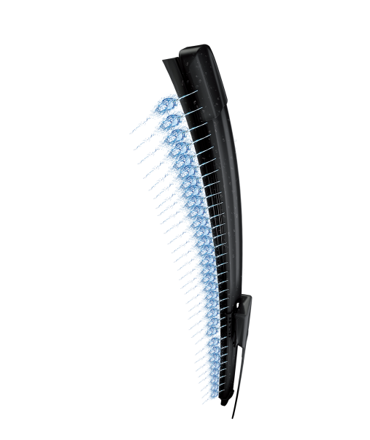

INNOVATIVE SUPPLIER
More than
80%
of Commercial Vehicles in Europe equipped with SWF
  More than
  350 000
  wiper blades
  manufactured
  every day
96 years
of passion for innovation
Notes:
Why is Valeo a legitimate player for the aftermarket solution in this range?
Legitimacy via technology or beacause leader or because OE adquisitions
Market share OE or growth OE
Innovation OE/IAM
Quality references (awards)
Integration in Valeo Group strategy (smart, green solutions...)
Product regognition IAM or OE

Slide 5
CV SWF WIPERS OFFER
WHY CHOOSE SWF?
Make your fleet life easier
with SWF wiper blades

Slide 6



New
Bulk Offer available by Q1 2019
100% metal structure providing robustness
Efficient and
Long-lasting rubber
For a perfect wipe whatever the conditions
100%
of the range
Made in Europe
Trucks range respects
100% O.E. specifications
Notes:
Why is Valeo a legitimate player for the aftermarket solution in this range?
Legitimacy via technology or beacause leader or because OE adquisitions
Market share OE or growth OE
Innovation OE/IAM
Quality references (awards)
Integration in Valeo Group strategy (smart, green solutions...)
Product regognition IAM or OE

Slide 7
CV SWF WIPERS OFFER
GROWTH OPPORTUNITIES
Develop your business in the most simple way: with Valeo Service

Slide 8


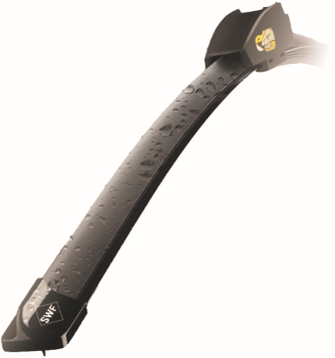
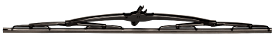


z
THE ESSENTIALS
CHOOSE THE RIGHT CARDS
NEW CARDS
MAKE A DIFFERENCE WITH VALEO
SWF Ref | Length (mm) | Range
132000 | 1000 | SWF - Das Original Trucks
132001 | 1000 | SWF - Das Original Trucks
132400 | 400 | SWF - Das Original Trucks
132451 | 450 | SWF - Das Original Trucks
132502 | 500 | SWF - Das Original Trucks
132551 | 550 | SWF - Das Original Trucks
132560 | 560 | SWF - Das Original Trucks
132601 | 600+600 | SWF - Das Original Trucks
132602 | 600+600 | SWF - Das Original Trucks
132603 | 600 | SWF - Das Original Trucks
132651 | 650+650 | SWF - Das Original Trucks
132652 | 650 | SWF - Das Original Trucks
132653 | 650 | SWF - Das Original Trucks
132702 | 700 | SWF - Das Original Trucks
132703 | 700 | SWF - Das Original Trucks
132704 | 700 | SWF - Das Original Trucks
132705 | 700 | SWF - Das Original Trucks
132801 | 800 | SWF - Das Original Trucks
132900 | 900 | SWF - Das Original Trucks
132901 | 900 | SWF - Das Original Trucks
SWF Ref | Length (mm) | Range
133550 | 550 | SWF - VisioFlex® Trucks
133600 | 600 | SWF - VisioFlex® Trucks
133601 | 600 | SWF - VisioFlex® Trucks
133602 | 600 | SWF - VisioFlex® Trucks
133650 | 650 | SWF - VisioFlex® Trucks
133651 | 650 | SWF - VisioFlex® Trucks
133652 | 650 | SWF - VisioFlex® Trucks
133653 | 650 | SWF - VisioFlex® Trucks
133700 | 700 | SWF - VisioFlex® Trucks
133702 | 700 | SWF - VisioFlex® Trucks
133703 | 700 | SWF - VisioFlex® Trucks

